Slide 1
Lesson IX
Conjunctions

Slide 2
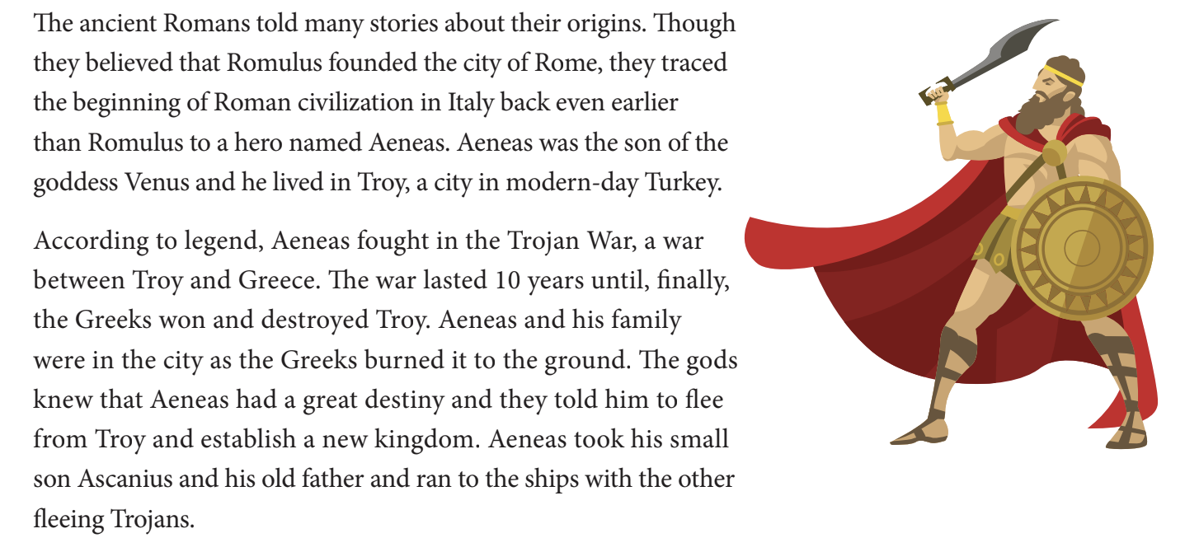
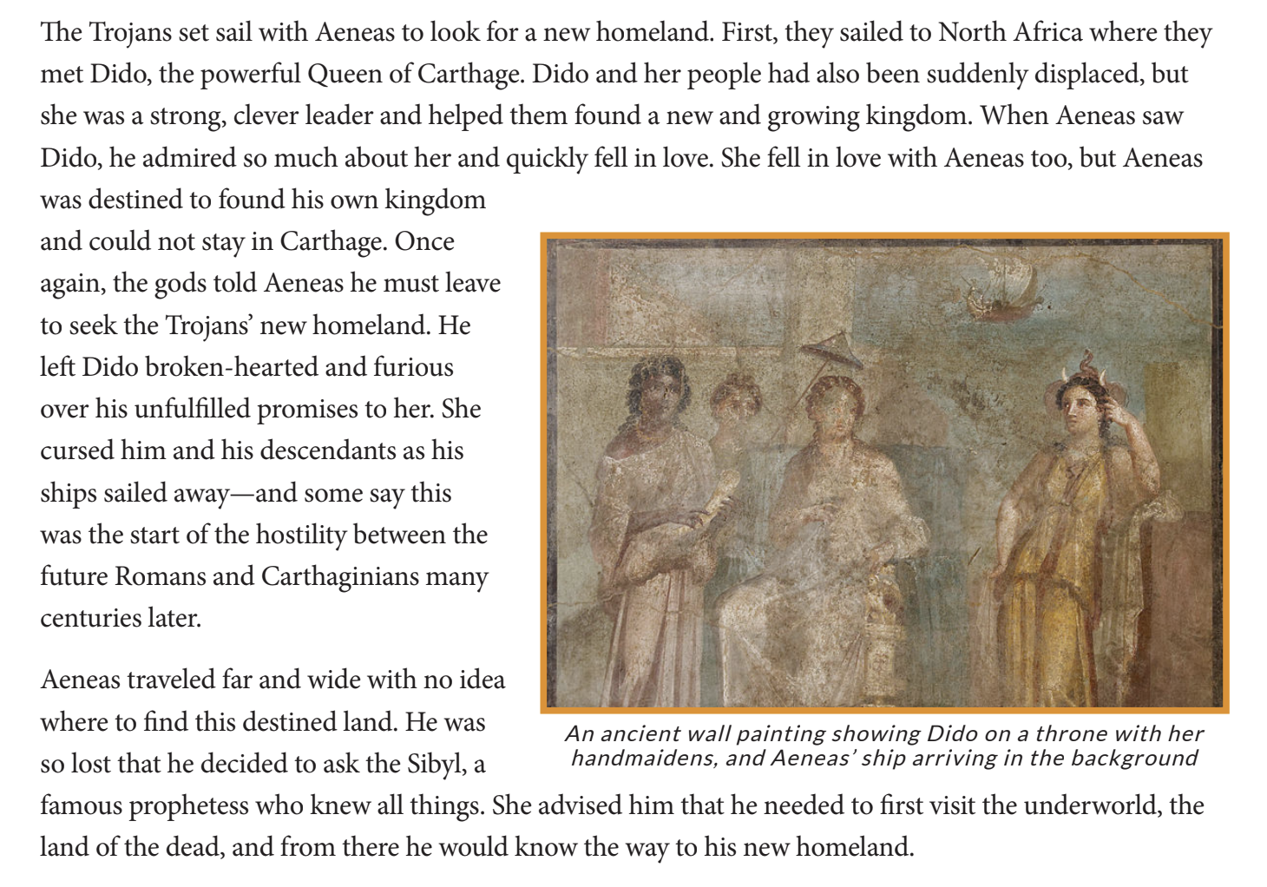
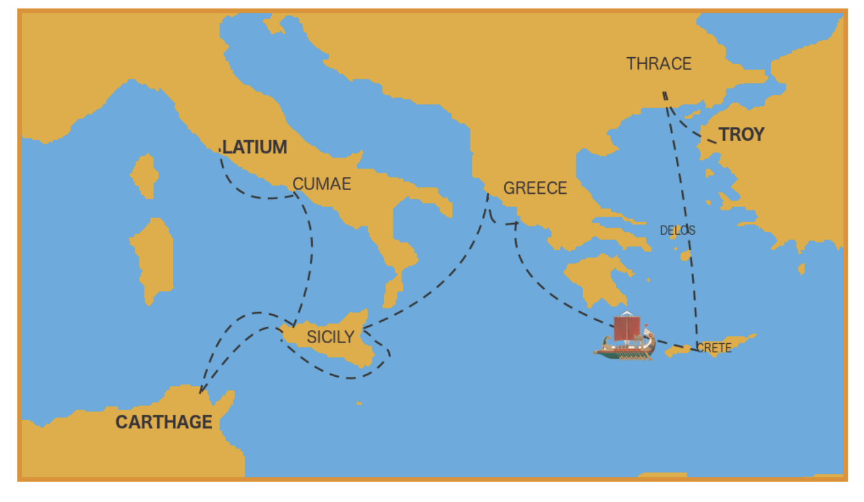
Aeneas’ Voyage

Slide 3
Conjunctions
“et” - and
“sed” - but
“quod” -because
“aut” - or
Notes:
Conjunctions are parts of speech used to connect clauses in a sentence. Here are some examples of conjunctions in Latin. These will also be on the vocab list to look at later on.

Slide 4
Conjunction Practice
Puer et puella
Ambulat quod habetis cibum
Tabula aut stilus?

Slide 5
Conjunction Practice (Answers)
Boy and girl
I walk because y’all have food
Writing board or pencil?

Slide 6
Lesson 9 Vocab
Nouns
ianua, -ae, f. - door
regina, -ae, f. - queen
___________________________
Conjunctions
et - and
sed - but
quod -because
aut - or

Slide 7
Practice with Vocab
Amat cibum et reginam
Puellae ambulant celeriter prope ianuam
Fillae aut puerī?

Slide 8
Practice with Vocab Answers
She loves the food and the queen
The girls walk quickly near the door
The girls or the boys?

