Slide 1
Lesson VII
Adjectives
Notes:
In today’s lesson, we will be learning about Latin adjectives. We will also cover some more vocabulary, as well as looking at the story of Baucis and Philemon.

Slide 2
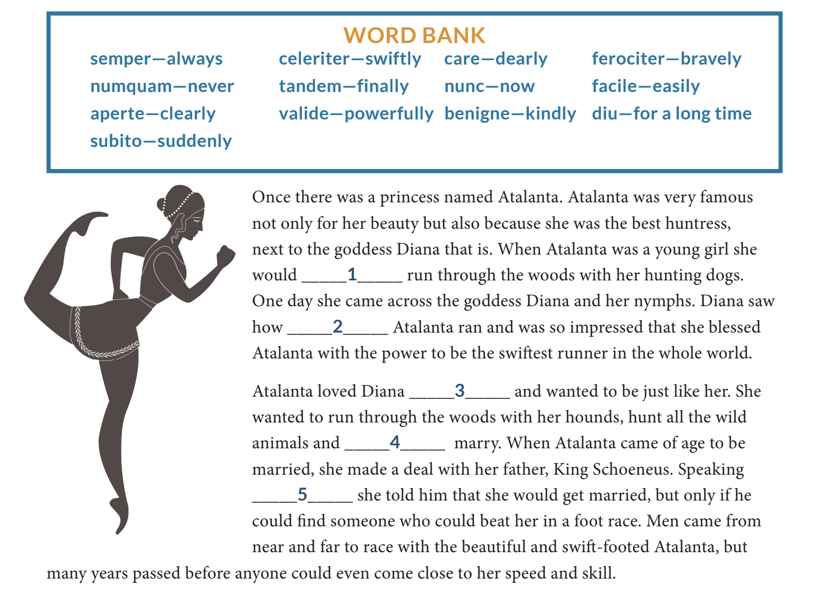
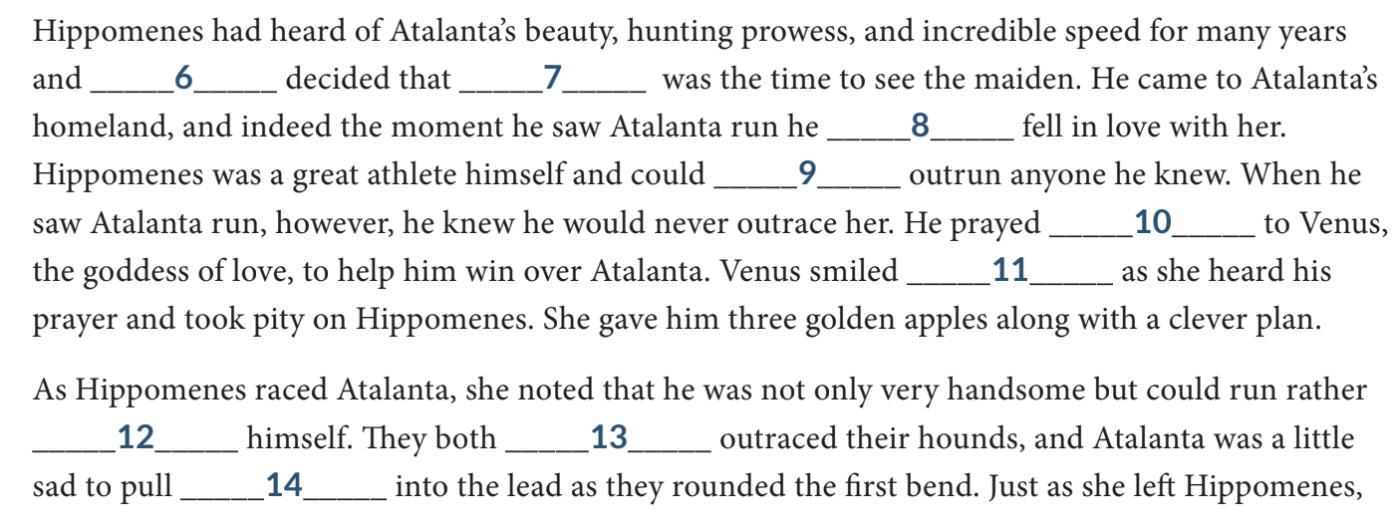
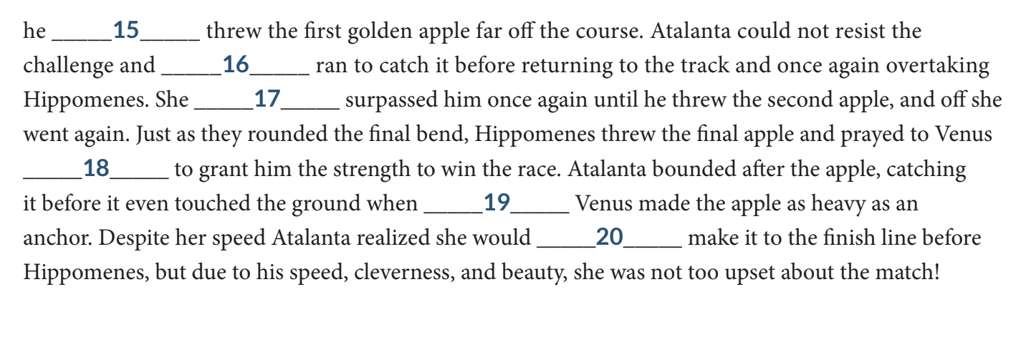
Atalanta and the Golden Apples

Slide 3
Latin Adjectives (2-1-2 adjectives)
bonus, bona, bonum - good
 | sg. (masc.) | pl. (masc.) | sg. (fem.) | pl. (fem.) | sg. (n.) | pl. (n.)
nom. | bonus | bonī | bona | bonae | bonum | bona
gen. | bonī | bonōrum | bonae | bonārum | bonī | bonrōrum
dat. | bonō | bonīs | bonae | bonīs | bonō | bonīs
acc. | bonum | bonōs | bonam | bonās | bonum | bona
abl. | bonō | bonīs | bonā | bonīs | bonō | bonīs
voc. | bone | bonī | bona | bonae | bonum | bona
Notes:
In speech, adjectives are used to describe a noun. Let’s look at some Latin adjectives. The adjectives we will learn today are 2-1-2 adjectives, which means that they are ordered as being written for 2nd declension (masc.), 1st declension (fem.), and 2nd declension (n.). On the voacb slide, more 2-1-2 adjectives will be given, but their ends are (for the most part) the same as “bonus, bona, bonum”

Slide 4
Latin Adjectives in Sentences
bona puella
bonō amīcō
bonārum fillārum
bonō puerō
Notes:
Now let’s try applying our adjective to some sentences

Slide 5
Latin Adjectives in Sentences (Answers)
the good girl
with the good friend
of the good sisters
for the good boy

Slide 6
English to Latin

Slide 7
Lesson 7 Vocab
Nouns
poeta, -ae, f. - poet
liber, ī, m. - book
_____________________________________________
Verb
ambulō, ambulāre (like amō, amāre) - to walk
_____________________________________________
Adjectives
bonus, bona, bonum - good
magnus, magna, magnum - big
bellus, bella, bellum - beautiful

Slide 8
Practice with Vocab
Bonae fillae docēt puerum
Ambulāmus ad magnum amīcum
Bella puella amat cibum

Slide 9
Practice with Vocab Answers
The good sisters teach the boy
We walk to the big friend
The beautiful girl loves food

Slide 10
English to Latin

