Slide 1
Lesson VI
Prepositions
Notes:
In today’s lesson, we will learn about prepositions in Latin, as well as reviewing our previous vocab and learning some new vocab words and learning a new verb conjugation.

Slide 2
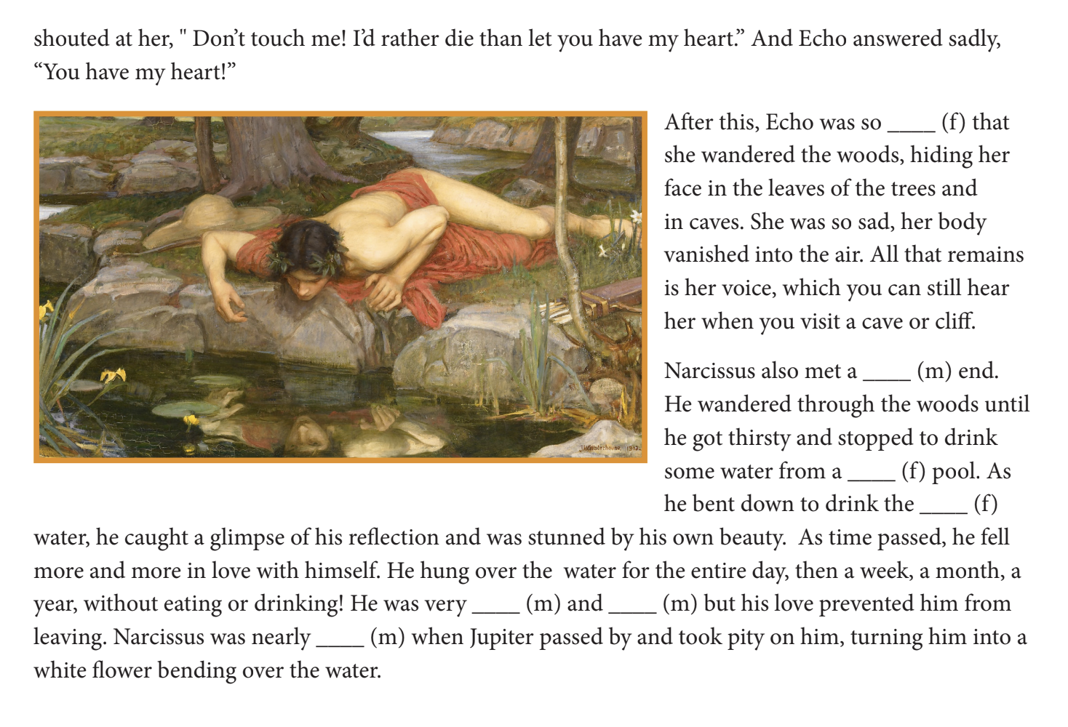
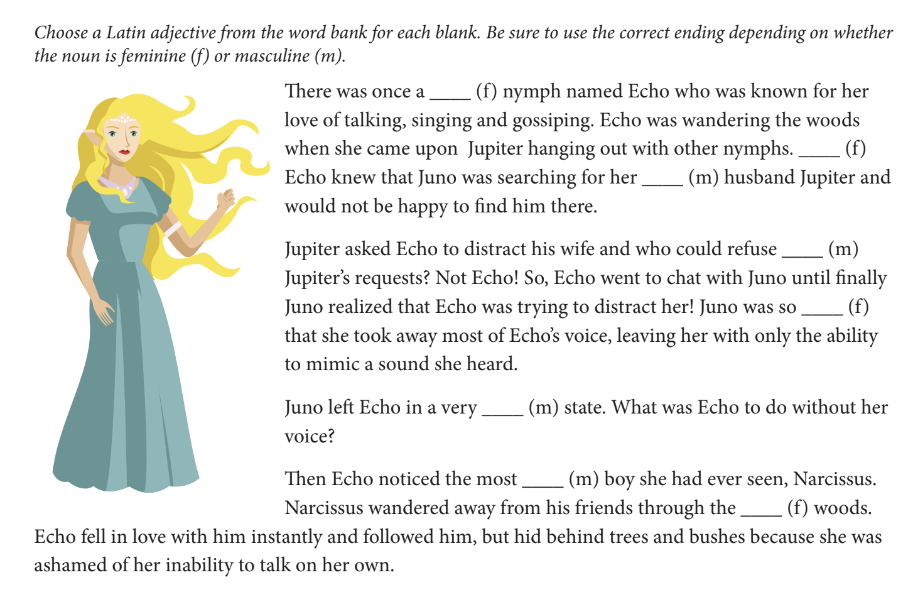
Echo and Narcissus

Slide 3
Prepositions
“prope” - near
“in” - in
“ex” - from/out of
“ad” - to/towards
Notes:
So what are prepositions? Prepositions in English are words used to introduce an object, or to indicate a relationship between two things through direction, space, time, etc. Let’s look at some basic Latin prepositions. We will see these later on the vocab list, but be sure to take a good look at them now.

Slide 4
Prepositions Take Cases
“prope” + accusative case - near
“in” + ablative case - in
“ex” + genitive case - from/out of
“ad” + accusative case - to/towards
Notes:
It is important to notes that while prepositions might not decline like nouns, they are paired with nouns that are in a specific case. For example, you would say “running to the girl”. In this sentence, “girl” would take the accusative case, as that is the case that “ad” goes with. Let’s now look at the same list of prepositions, but include the case that they take.

Slide 5
Prepositional Phrases
In silenō
Ad amīcum
Prope puellam
Notes:
Let’s now practice using our newly learned prepositions in prepositional phrases! Attempt to translate the prepositional phrases into English

Slide 6
Prepositional Phrases (Answers)
In silence
To the friend
Near the girl

Slide 7
3rd Conjugation Verbs
Currō, currēre - to run
 | Singular | Plural
1st Person | currō | currimus
2nd Person | curris | curritis
3rd Person | currit | currunt
Notes:
Here is a 3rd conjugation verb

Slide 8
Lesson 6 Vocab
Nouns
puer, -ī, m. - boy
fillia, -ae, f. - sister
_________________________________________________________
Verb
currō, currēre - to run
_________________________________________________________
Prepositions
prope (+acc. case) - near
in (+abl. case) - in
ex (+gen, case) - out of/from
ad (+acc. case) - to/towards

Slide 9
Practice with Vocab
Puella habēt cibum in silentō
Currimus ad puerōs
Doceō amīcum prope fillam

Slide 10
Practice with Vocab (Answers)
The girl has food in silence
We run to the boys
I teach the friend near the sister

Slide 11
Write English to Latin

