Slide 1
Lesson V
Neuter Nouns

Slide 2
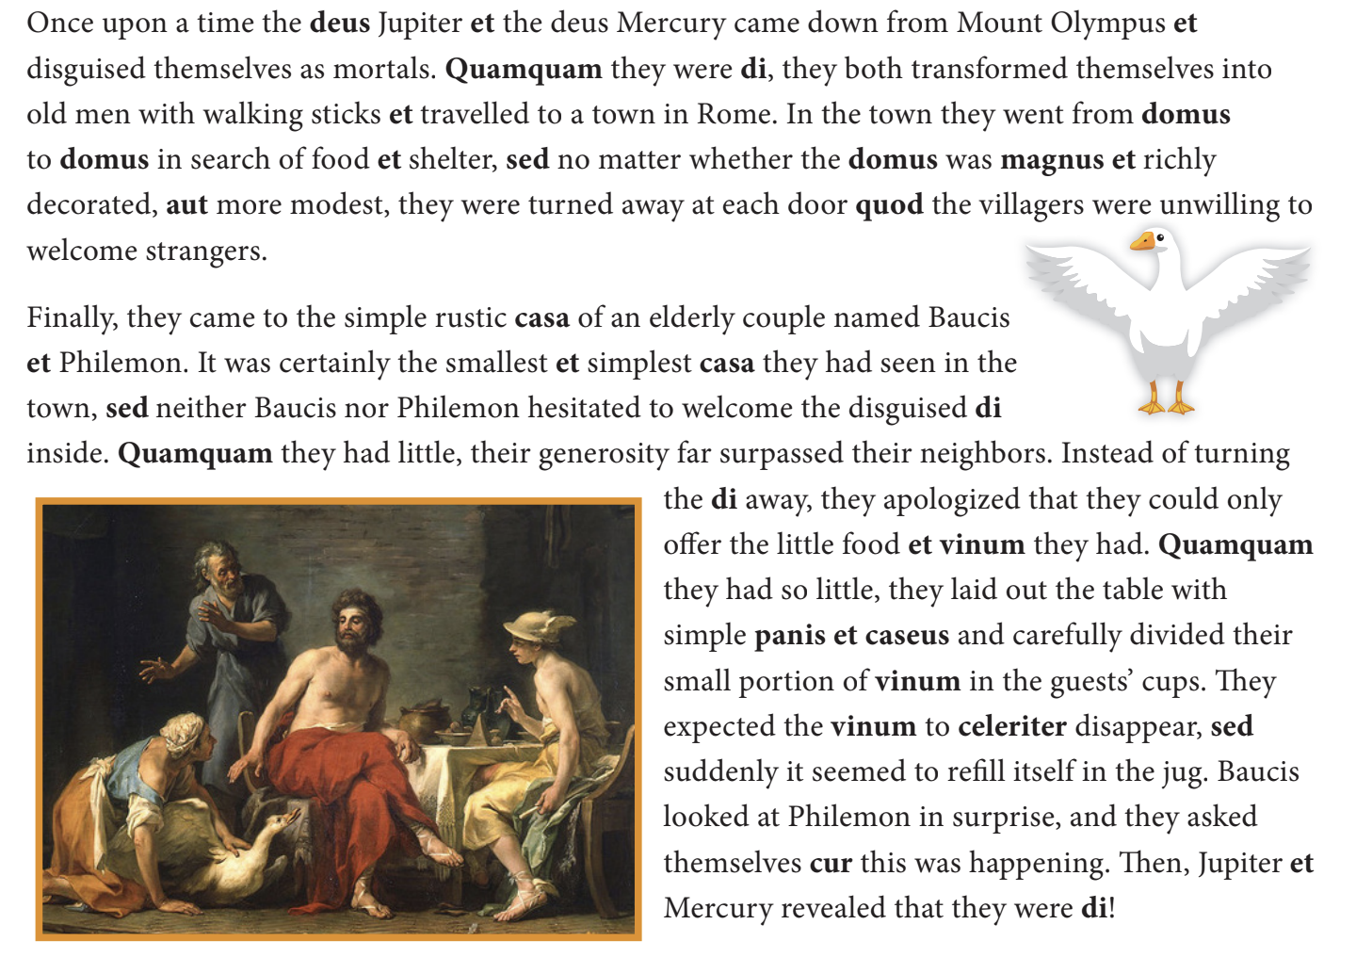
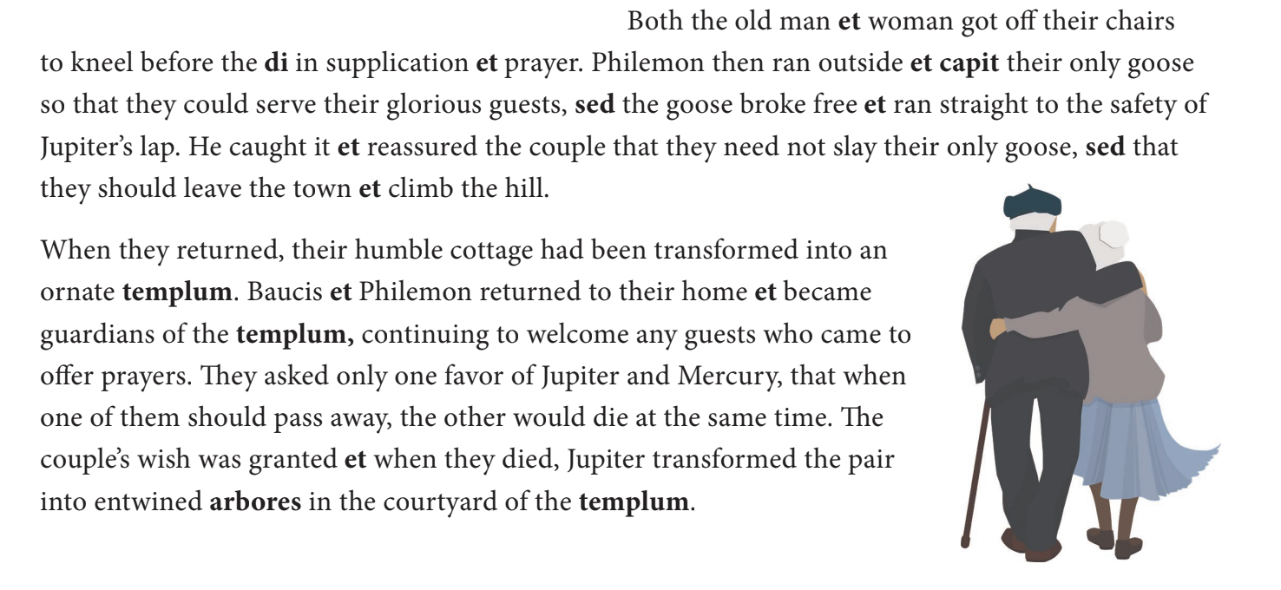
Baucis and Philemon

Slide 3
Review of Lesson 4
Genitive Case - Case of possession
Dative Case - to/for whom an action happens
Ablative Case - how is something done (with/by)
Vocative Case - Case of address
Notes:
Before we begin today’s lesson, here is a quick overview of Lesson 4, where we talked about the different cases of nouns and what their purpose is. If you forget about their purpose and want a deeper dive again, go back and look again at Lesson 4.

Slide 4
Neuter Nouns (2nd Declension)
 | Singular | Plural
Nom. | bellum | bella
Gen. | bellī | bellōrum
Dat. | bellō | bellīs
Acc. | bellum | bella
Abl. | bellō | bellīs
Voc. | bellum | bella
Notes:
To preface this, unlike feminine nouns, which show up predominantly in the first declension, neuter nouns are prevalent in both the second and third declension. Since we have not learned the third decision yet, today’s lesson on neuter nouns will be focused specifically on neuter nouns in the second declension. Here is a chart of what a second declension neuter noun looks like.

Slide 5
2nd Declension Neuter and Masculine Compared
 | Singular | Plural
Nom. | cibus | cibī
Gen. | cibī | cibōrum
Dat. | cibō | cibīs
Acc. | cibum | cibōs
Abl. | cibō | cibīs
Voc. | cibe | cibī
Notes:
Compare the chart you just saw with this second declension masculine chart. What are some similarities you can see between the two charts? Hint: some cases have the same endings.

Slide 6
Lesson 5 Vocab
Nouns
silentium, ī, n. - silence (like bellum)
amīcus, ī, m. - friend (like cibus)
_________________________________________________________________
Verb
Doceō, docēre - to teach (like habeō)
Notes:
Starting with Lesson 5, vocab sets for each chapter to build up words to be used in sentences will be introduced. Only nouns and verbs whose declension/conjugation have been taught before will be used.

Slide 7
Practice with Vocab
Puellae docēnt amīcum
Amīcus amāt silentium
Amāmus amīcōs puellae
Habēnt cibōs puellīs
Amīcī, puellae amānt cibum silentiō.
Notes:
Now you try! Translate these Latin sentences into English.

