Slide 1
Lesson IV
Basic Nouns and Verbs (Continued)

Slide 2
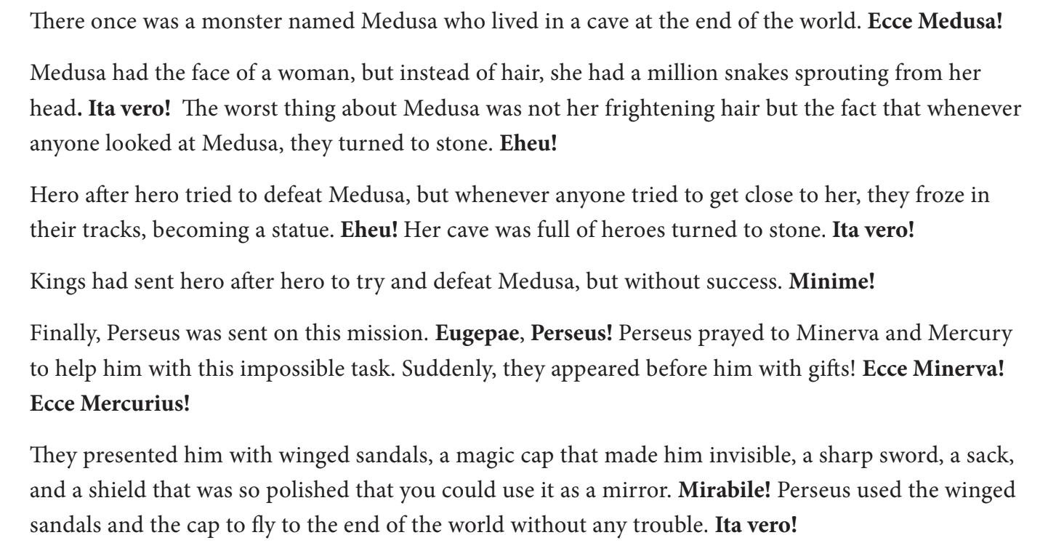
Perseus and Medusa

Slide 3
Full Noun Declension of First Declension Nouns
 | Singular | Plural
Nom. | Puella | Puellae
Gen. | Puellae | Puellārum
Dat. | Puellae | Puellīs
Acc. | Puellam | Puellās
Abl. | Puellā | Puellīs
Voc. | Puella | Puellae
Notes:
In the previous lesson, we only covered the basics of nouns, such as the nominative and the accusative cases. But to dive deeper, we need to learn the full declensions of Latin nouns, and we need to understand what purposes the other cases of Latin nouns serve in a sentence. Let’s start by giving a visual example of what the full noun declension of a first declension noun is.

Slide 4
Full Noun Declension of Second Declension Nouns
 | Singular | Plural
Nom. | Cibus | Cibī
Gen. | Cibī | Cibōrum
Dat. | Cibō | Cibīs
Acc. | Cibum | Cibōs
Abl. | Cibō | Cibīs
Voc. | Cibe | Cibī
Notes:
Now let’s look at the full noun declension of a Second declension noun. Again, let’s only think of second declension nouns as masculine, for now

Slide 5
Genitive Case
Case of possession (of)
English Example - The food of the girl
Latin Example - Cibus puellae
Notes:
The basic use of the genitive case in Latin is to show possession of something. The word in a latin sentence that would take the genitive case would be the word that has the possession of the object. The food is not in the possession of the girl, but rather the girl is in possession of the food.

Slide 6
Dative Case
To whom an action happens (to/for)
English Example - The girl is loving for the food
Latin Example - Puella amat cibō
Notes:
The dative case explains to whom an action happens. Although the example in Latin does not fully express the full function of the dative, it serves its purpose, albeit quite awkward in English. In Latin, the sentence shows you that it is the word that is taking the word “for” with it in the dative.

Slide 7
Ablative Case
The case of many uses (with/by)
English Example - The girl loves with food
Latin Example - Puella amat cibō
Notes:
The ablative case has many uses, but for today, we will stick to its most basic translation, “with” or “by”. The english example can also be translated as “The girl is loving by means of the food”. Essentially, the girl is showing her love through the vehicle of food. Something to notice is that the latin sentence of both our dative and ablative cases are the same. If this happens while reading Latin, it is up to the reader to determine which case is being used by the author through context clues. Sometimes, both translations can work!

Slide 8
Vocative Case
The case of address
English example - Oh, girls!
Latin example - Puellae!
The exclamation point shows that “Puellae” is most likely a vocative!
Notes:
The vocative case is probably the least used case in Latin. It is just the case used to address someone while talking to them. For example, if I were to call one of your names in Latin, I would be using the vocative case. Again, you can see that Puellae is also the latin form for the genitive singular, dative singular, and nominative plural. One can normally spot a vocative because it stands alone in a clause, either before a period or a comma.

Slide 9
Second Conjugation Verbs
Habeō, Habēre, Habuī, Habītum = to have
 | Singular | Plural
1st Person (I/We) | Habeō | Habēmus
2nd Person (You/Y’all) | Habēs | Habētis
3rd Person (She, He, It/They) | Habet | Habent
Notes:
Before we end the lesson, it is important that we talk about second conjugation verbs. Let’s take a look at a chart of a second conjugation verb in the present tense.

Slide 10
Now You Try!
Habētis cibum puellae
Puella! Amāmus cibum
Habeō cibum puellīs
Notes:
To finish this lesson, try some mixed sentences that involve all the vocab we have learned so far, as well as different cases and and verb conjugations.

