Slide 1
Lesson III
Basic Nouns and Verbs

Slide 2
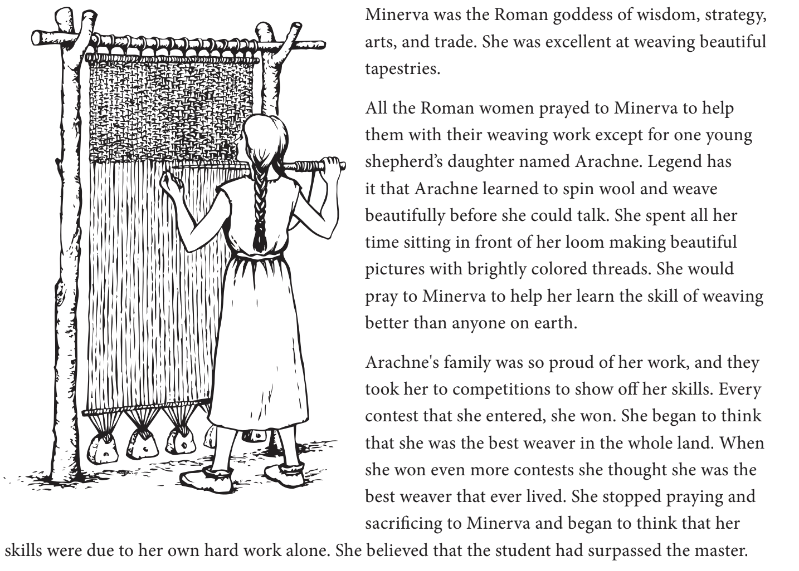
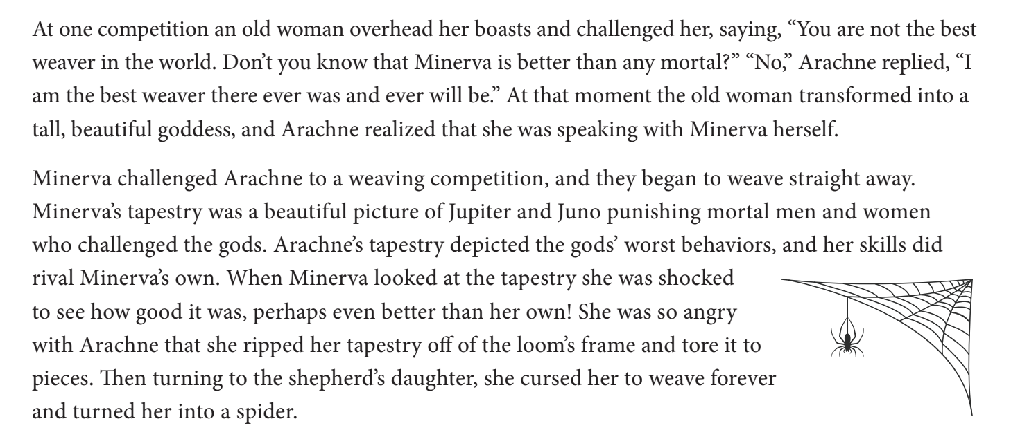
Arachne and Minerva
Notes:
Ask if they notice any patterns.

Slide 3
Gendered Nouns
Feminine | Masculine
Alexandra | Alexander / Alejandro
Edwina | Edward
Victoria | Victor
Cornelia | Cornelius
Georgia/Georgina | George
Notes:
We’re not used to words having genders in English, but in most European languages, especially romantic one, they do! Most nouns are either masculine or feminine, and the gender of the noun informs which article you use. Do you notice any patterns?
Ask if they notice any patterns.

Slide 4
Plurals
Singular | Plural
Formula | Formulae
Octopus | Octupi
Cactus | Cacti
Fungus
Vertebra
Notes:
We’re not used to words having genders in English, but in most European languages, especially romantic one, they do! Most nouns are either masculine or feminine, and the gender of the noun informs which article you use. Do you notice any patterns?

Slide 5
Declensions are to Nouns what Conjugations are to Verbs
There are five declensions in Latin, but we will only need the first three:
1st Declension (mostly feminine)
2nd Declension (mostly masculine, some neuter)
3rd Declension (all three genders)
Notes:
There are many different declensions of nouns in Latin. Let’s start basic. Today we will be learning about the first and second declensions of nouns. Usually, first declension nouns are associated with being feminine, while second declension nouns are associated with being masculine. However, this is not the case all the time. There are a few cases of nouns in Latin, and each case has a different form of the noun. We will learn about cases later. Let’s just start with declining the first declension noun endings.
Next, let’s decline the second declension nouns endings.

Slide 6
Cases
1st Declension | Singular | Plural
Nominative | -a | -ae
Accusative | am | -ās
2nd Declension | Singular | Plural
Nominative | -us | -ī
Accusative | -um | -ōs
Notes:
There are many different declensions of nouns in Latin. Let’s start basic. Today we will be learning about the first and second declensions of nouns. Usually, first declension nouns are associated with being feminine, while second declension nouns are associated with being masculine. However, this is not the case all the time. There are a few cases of nouns in Latin, and each case has a different form of the noun. We will learn about cases later. Let’s just start with declining the first declension noun endings and two basic cases, the nominative and the accusative. The nominative case can be viewed as the subject in any basic Latin sentence. In other words, it is the person place or thing doing the verb. The accusative case, on the other hand, is the object of the sentence, or the person place or thing that is receiving the verb.
Next, let’s decline the second declension nouns endings.

Slide 7
1st Declension Feminine Nouns
 | Singular | Plural
Nominative | -a | -ae
Accusative | -am | -ās
 | Singular | Plural
Nominative | Puella (girl) | Puellae (girls)
Accusative | Puellam | Puellās
Notes:
There are many different declensions of nouns in Latin. Let’s start basic. Today we will be learning about the first and second declensions of nouns. Usually, first declension nouns are associated with being feminine, while second declension nouns are associated with being masculine. However, this is not the case all the time. There are a few cases of nouns in Latin, and each case has a different form of the noun. We will learn about cases later. Let’s just start with declining the first declension noun endings.
Next, let’s decline the second declension nouns endings.

Slide 8
2nd Declension Masculine Nouns
 | Singular | Plural
Nominative | -us | -ī
Accusative | -um | -ōs
 | Singular | Plural
Nominative | Cibus (food) | Cibī (food)
Accusative | Cibum | Cibōs
Notes:
Next, let’s decline the second declension nouns endings. Let’s focus on 2nd declension nouns being masculine for now.

Slide 9
Verb Conjugation
Amō, Amarē, Amāvī, Amātum - To like, love
 | sg. | pl.
1st (I/We) | amō | amāmus
2nd (You/Y’all) | amās | amātis
3rd (She, He, It/They) | amat | amant
Notes:
For the final part of the lesson today, let’s learn some basic verbs! Today we will be focused on learning the principal parts of 1st conjugation verbs, as they normally are the same endings from verb to verb. Here are the principal parts of the verb to love. Now lets learn how to form it. In Latin, there are two “numbers” - singular and plural, and 3 “persons” - 1st, 2nd, and 3rd. The first person singular means “I love”, while the second person singular means “you love.” Recall our english Verb charts from Lesson 2 to help you here.

Slide 10
Sentence Structure
Puella amat cibum
Cibus amat puellās
Cibī amant puellam
Challenge!!!
Amās cibum
Amāmus puellās
Notes:
See if you are able to use your knowledge of nouns and a verb to translate these sentences into English.

Slide 11
2nd Declension Masculine Nouns
 | Singular | Plural
nom. | -us | -ī
gen. | -ī | -ōrum
dat. | -ō | -īs
acc. | -um | -ōs
abl. | -ō | -īs
Notes:
Next, let’s decline the second declension nouns endings. Let’s focus on 2nd declension nouns being masculine for now.

Slide 12
Now You Try!
 |  | pl.
nom. |  | -ae
 | -ae
dat. |  | -īs
acc. |  | -ās
 | -ā
Notes:
Now you try. See if you can finish this chart of first declension noun endings.

Slide 13
Now You Try!
 | sg.
 |  | Clamāmus
 | Clamās
3rd |  | Clamant
Notes:
Now try to complete this chart of 1st conjugation verb endings! Use the verb Clamō, which means to shout. It should have the exact same endings as the chart we did with Amō.

