Slide 1
Lesson II
Relevance of The Classics Today

Slide 2
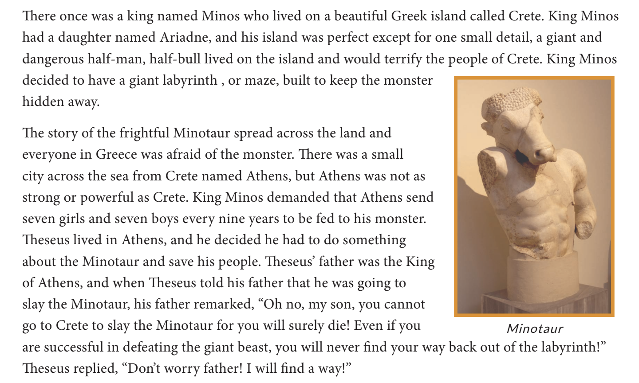
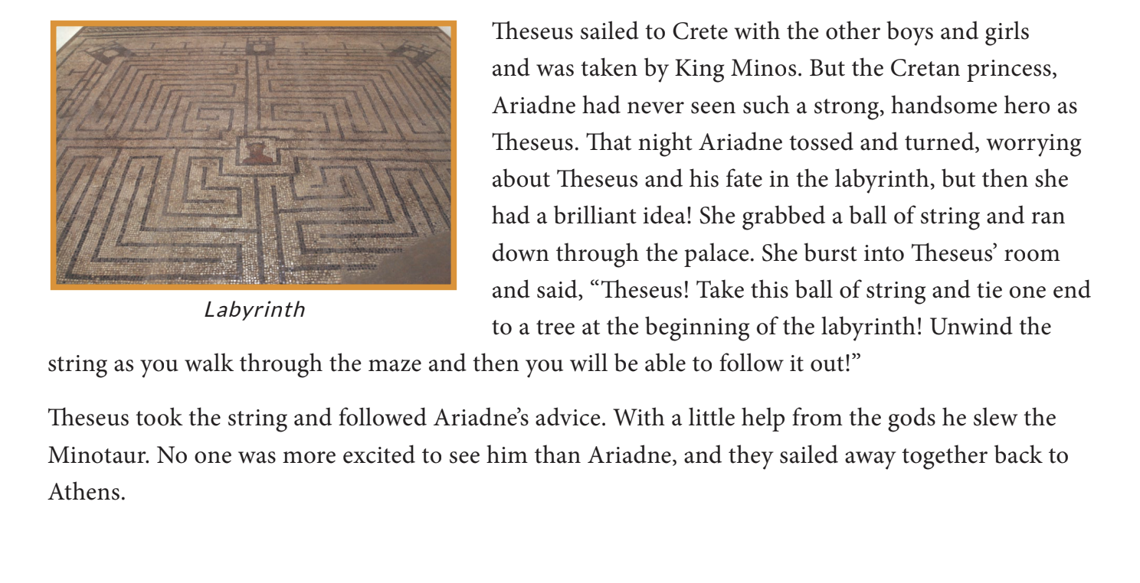
Theseus and the Minotaur

Slide 3
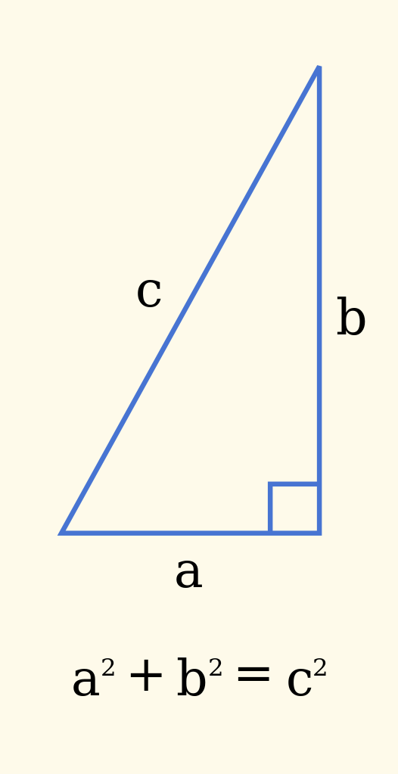
Classics in Mathematics
Euclid - basic geometry
Pythagoras - Pythagorean theorem and π
Archimedes - law of displacement and pulley system
Notes:
Euclid - basic geometry
Pythagoras - Pythagorean theorem and π
Archimedes - law of displacement and pulley system, which uses mathematical equations to project launch distance from the launch angle

Slide 4
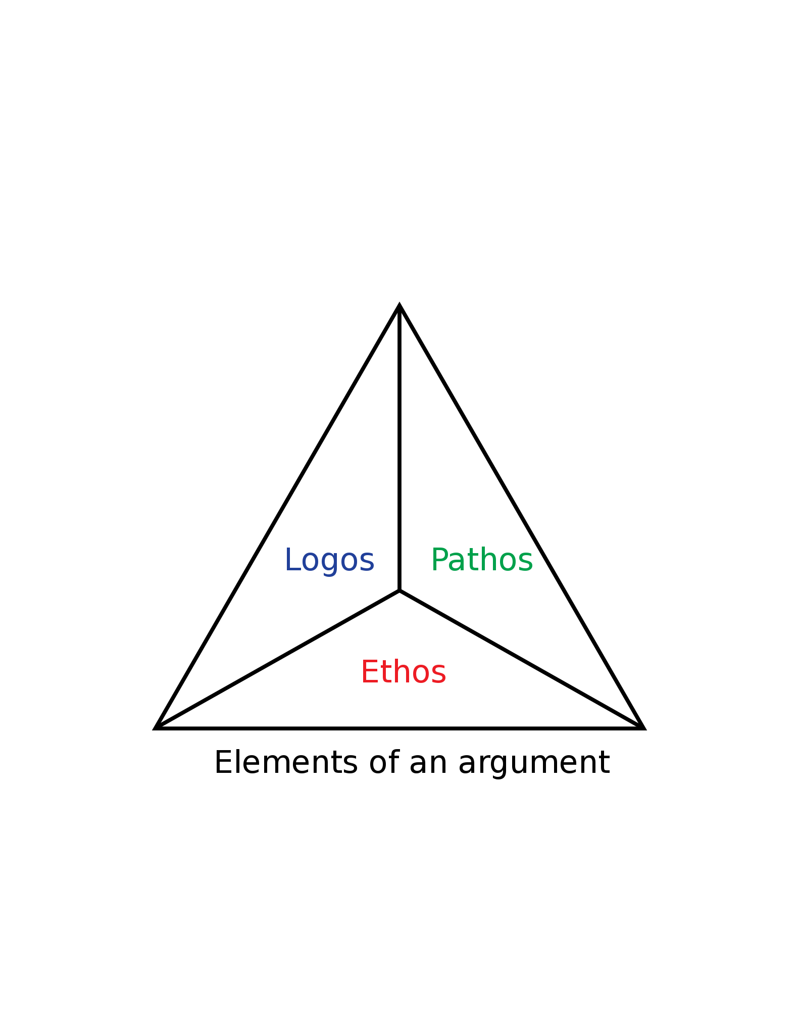
Classics in Politics
Aristotle - Ethos, Pathos, Logos
Cicero - docere, delectare, et movere
Notes:
Classical thinkers also have an effect on today’s politics
Aristotle believed in Ethos, Pathos, Logos (Status, emotion, logic) as ways to convince an audience on a point
Cicero thought that a politician should docere, delectare, et movere (to teach, to delight, to move)

Slide 5
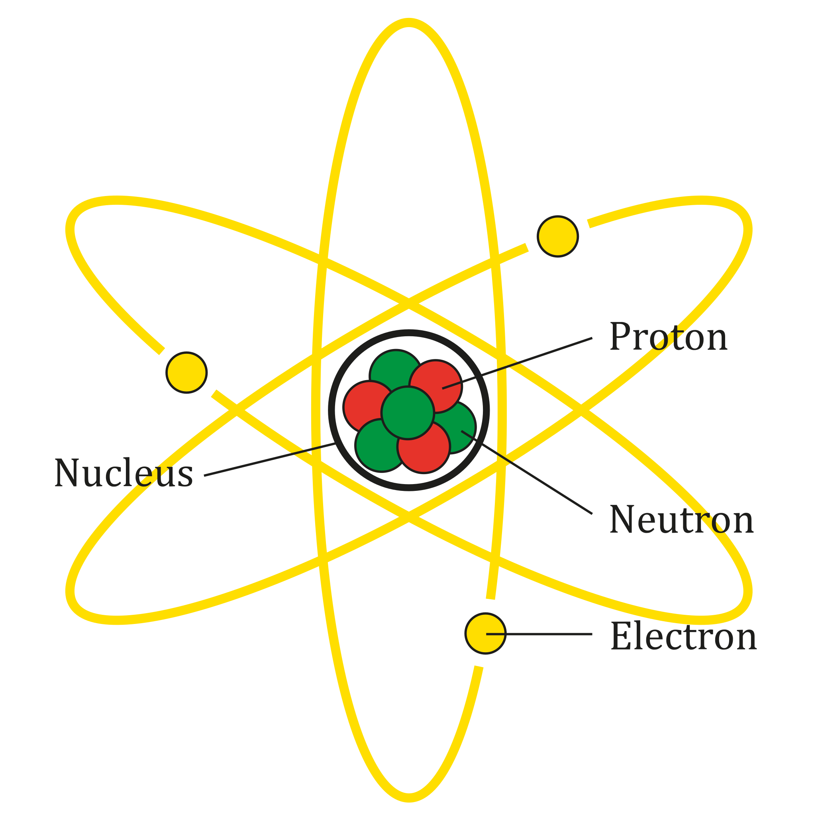
Classics in Philosophy
Socrates - Socratic method
Plato - 3 parts of the soul
Democritus - believed everything was made up of indivisible particles
Notes:
Moreover, in Philosophy, ancient Greek thinkers are revered
Socrates - Socratic method (individual thought process reveals the truth)
Plato - 3 parts of the soul (rational, spirited, and appetitive)
Democritus - believed everything was made up of indivisible particles (atoms)

Slide 6
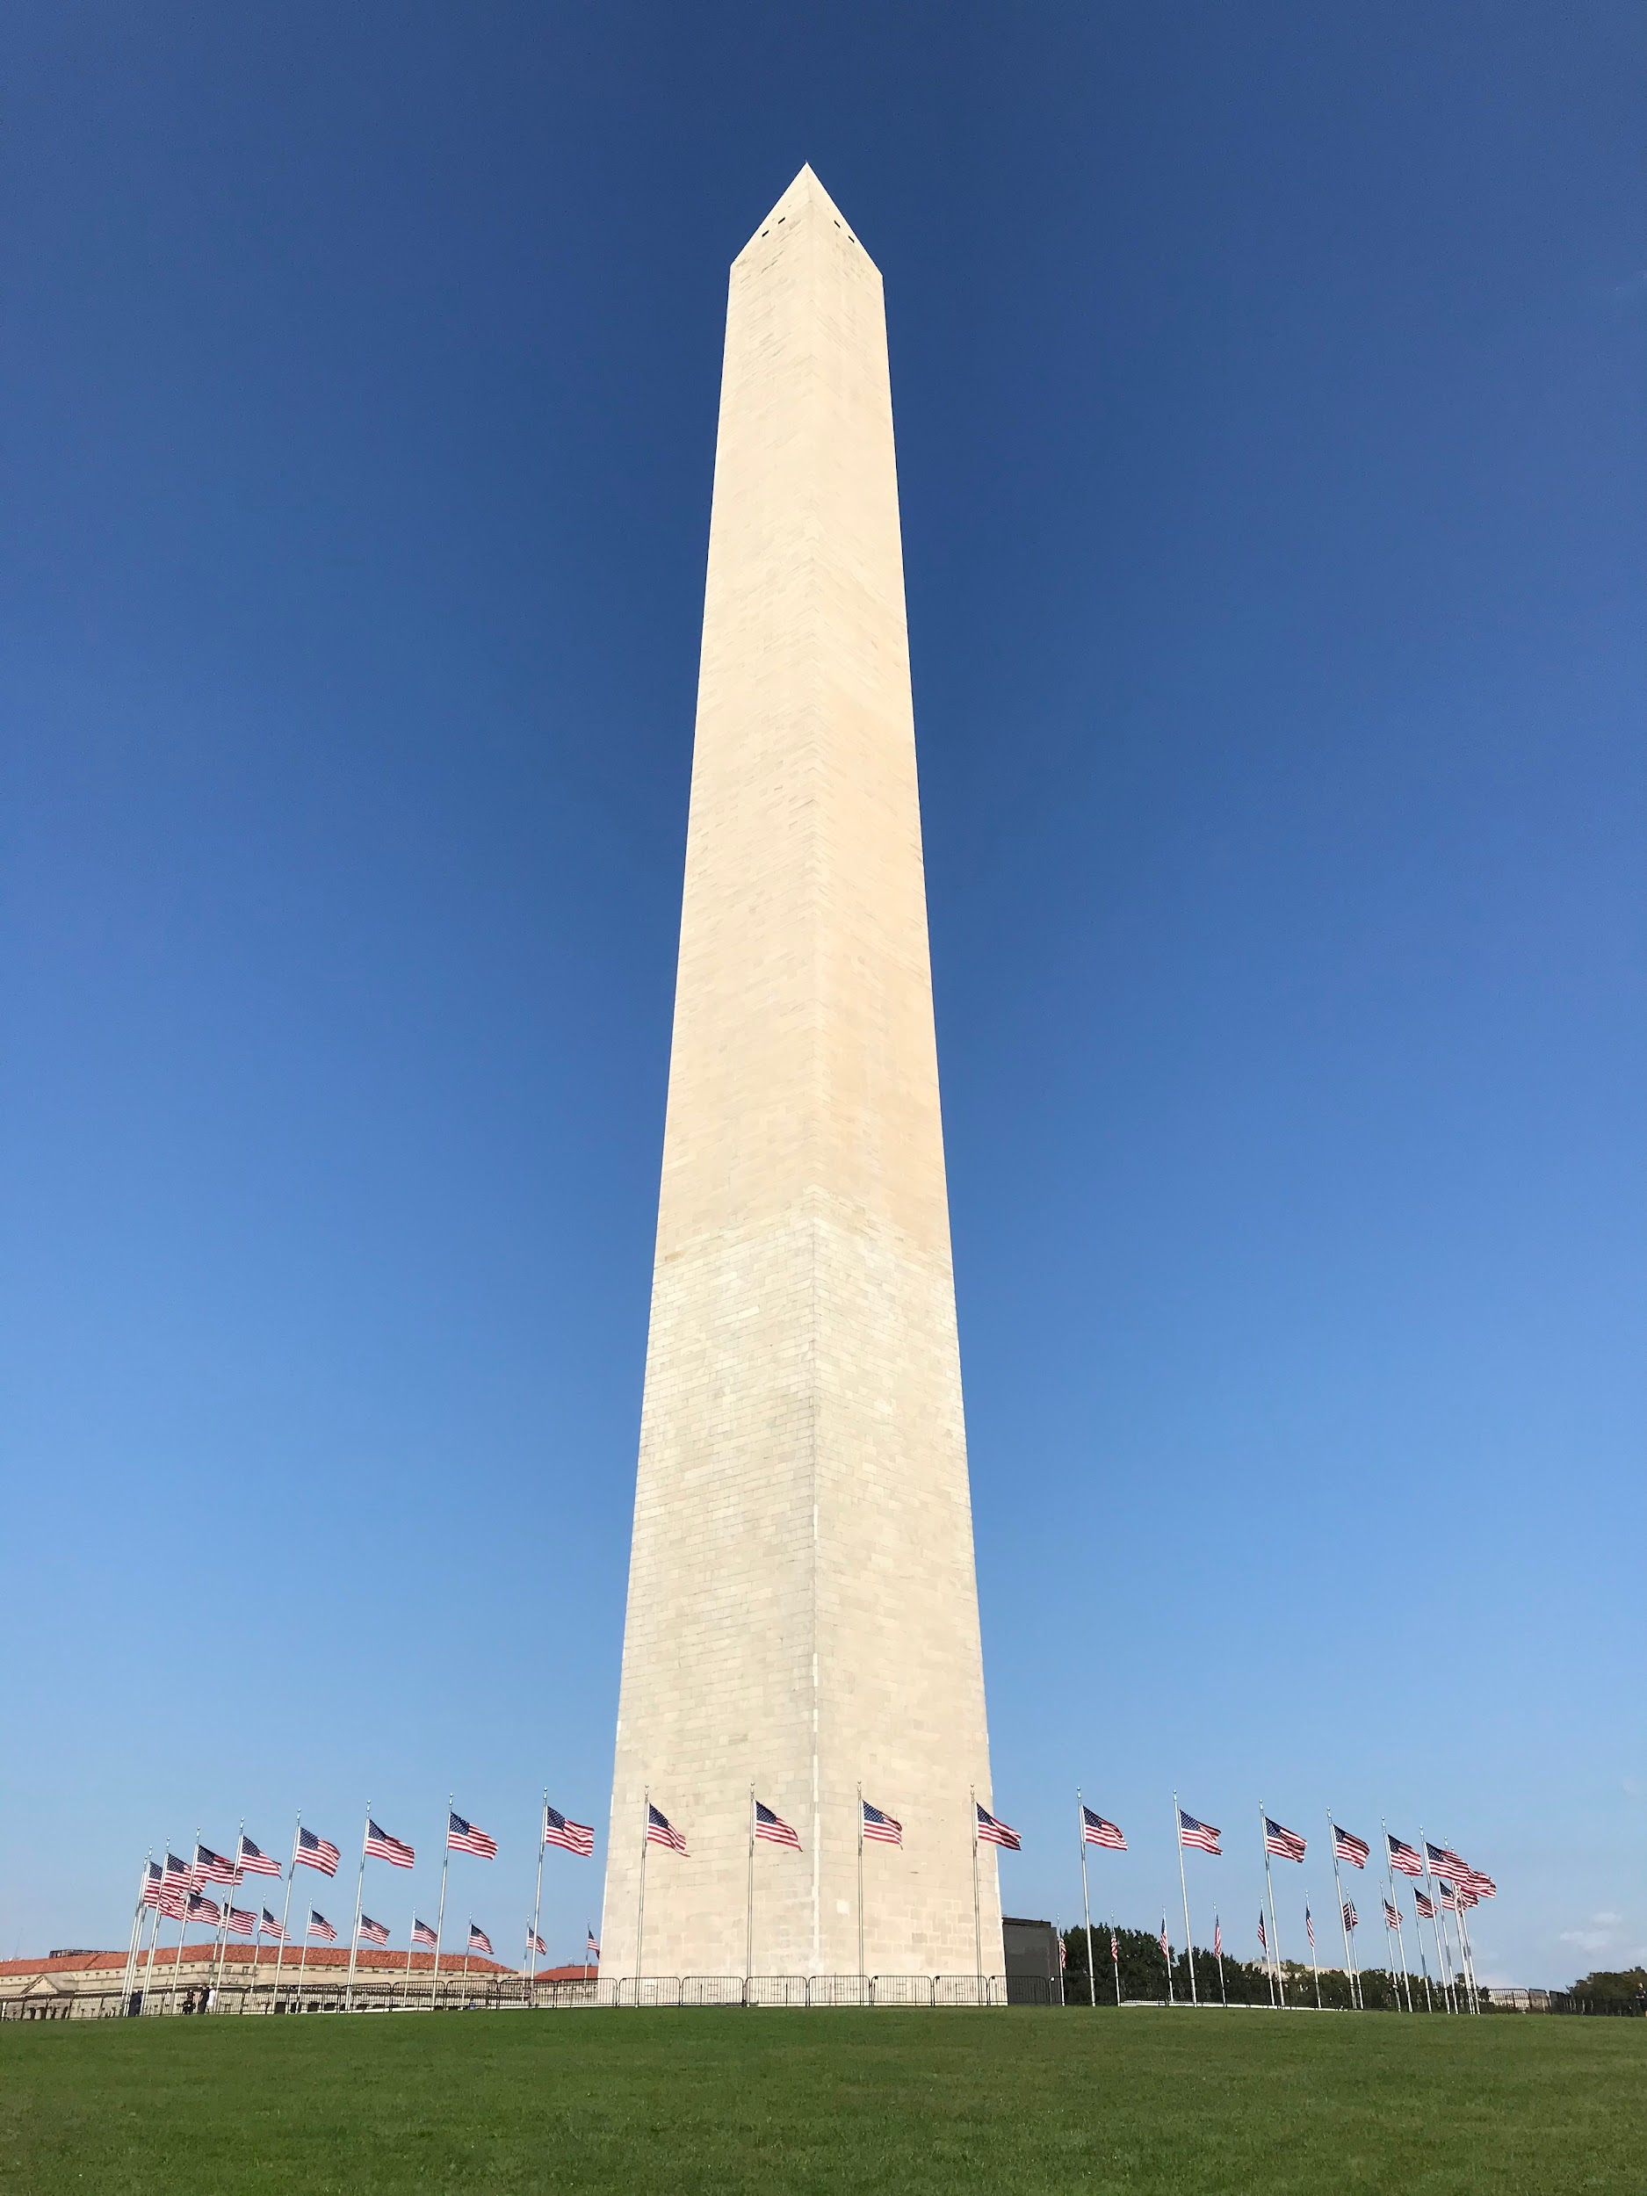
Classics in Architecture
Most US government architecture uses unpainted columns and the color white
Washington Monument = obelisk
Notes:
Finally, some modern architecture is based directly on Roman and Greek architecture
Most US government architecture is uses unpainted columns and the color white (a misconception as most columns in ancient Rome and Greek had color) (White house, capital building, Lincoln memorial)
Washington Monument is an obelisk, which is originally a building style found in Ancient Egypt, part of the Mediterranean basin that included ancient Greece and Rome

Slide 7
Why is this important?
Important for not just studying ancient culture, but also for understanding it
Notes:
It is important to know and understand the language and culture of these ancient languages, as they not only matter when studying ancient history, but also for fully understanding and immersing yourself in the world around you.

Slide 8
Conjugating English Verbs
Let’s conjugate “to be” in English
I am | We are
You are | You (pl) are
He/She/It is | They are

Slide 9
Conjugating English Verbs
Let’s conjugate “to walk” in English, but in the past tense
I walked | We walked
You walked | You (pl) walked
He/She/It walked | They walked

Slide 10
Conjugating English Verbs
Let’s try “to be” again, except this time, let’s keep the form “be” for our conjugation
I be | We be
You be | You (pl) be
He/She/It bes | They be

Slide 11
Verb Formations in Latin
To be - sum, esse, fuī, futūrus
Let’s conjugate in the Present Active Indicative
sum | summus
es | estis
est | sunt
Notes:
This is how a basic Latin Verb is conjugated. Given, this is not a normal verb, and has quite strange principal parts. However, see if you can figure out what each form means.

Slide 12
Latin Pronunciation Differences
Verbs
Consonants
 | Long | Short
A | Father | Hat
E | Key | Best
I | Sight | Sit
O | Bonus | Tot
U | Music | Cub
V | Wave
G | Gap
C | Cap
S | Uses
Notes:
Here is a key to guide you through some major differences between pronouncing English and pronouncing Latin. Long and short vowels are distinguished by a macron (ā vs a).

