Slide 1
Lesson X
Pronouns and Interrogatives

Slide 2
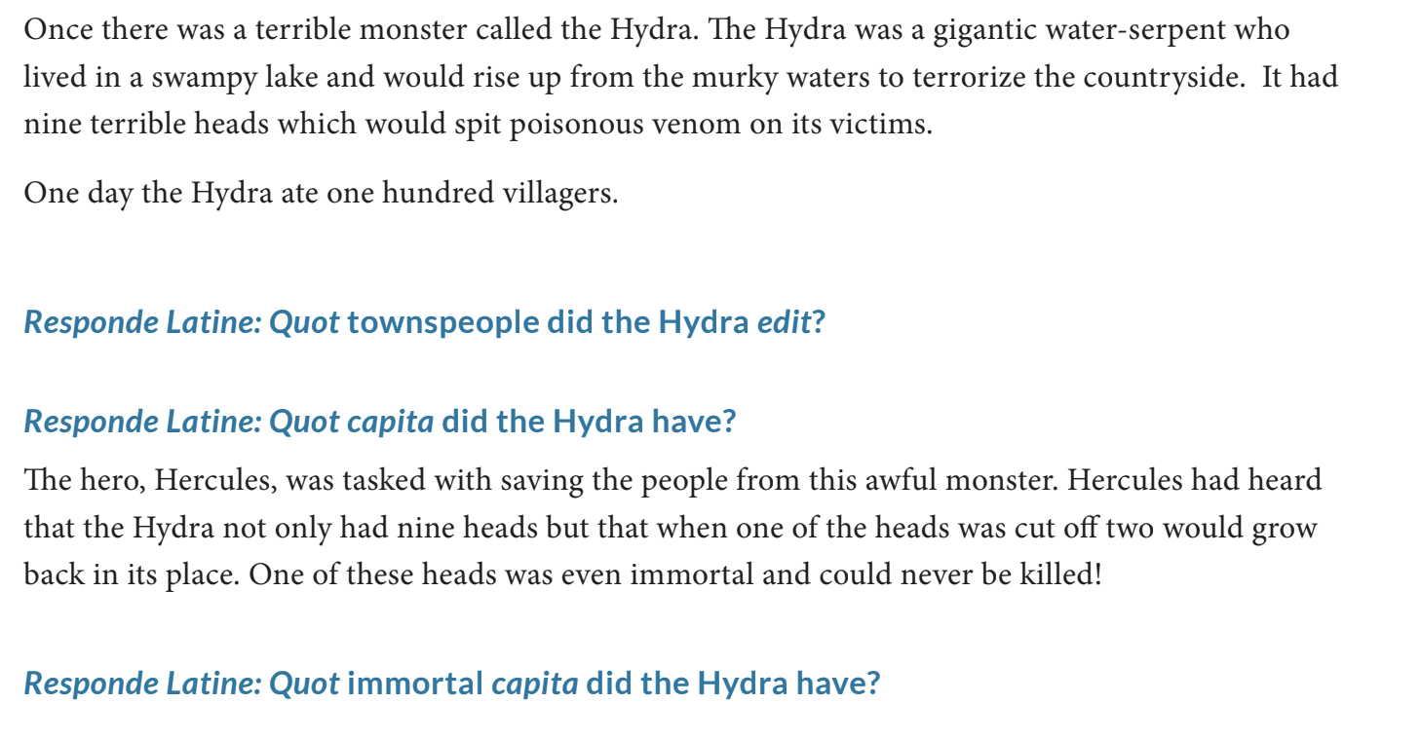
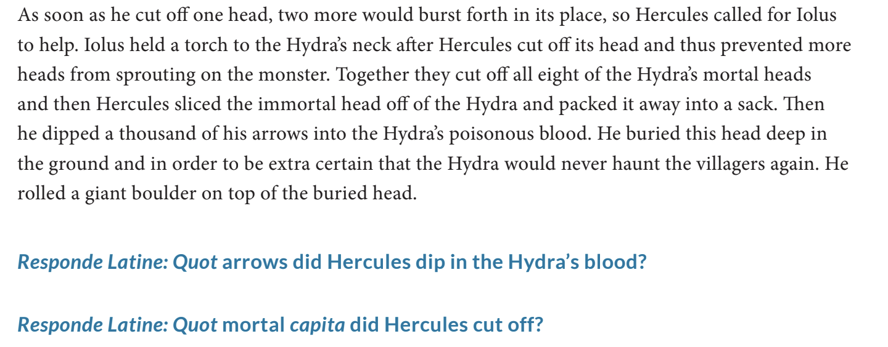
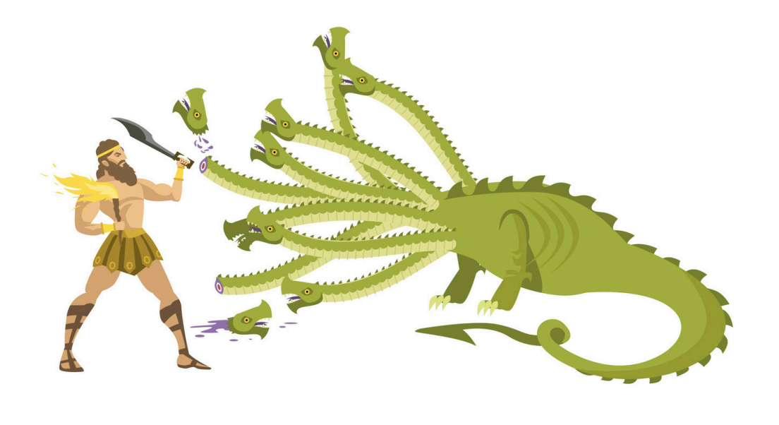
Hercules and the Hydra

Slide 3
Pronouns
“ego” - I
“me” - me
“illus” - he
“illa” - she
“illud” - it
“nos” - we/us
“vos” - y’all
Notes:
In our final lesson together, we will go over pronouns and interrogatives. In English, pronouns are used to refer back to a subject once they have been mentioned in a sentence. For example, in the sentence “Alicia will get her cookies,” her is the pronoun representing Alicia. Here are some examples of pronouns in Latin. Pronouns, just like nouns, take cases, but for now, we will only learn the nominative case of pronouns.

Slide 4
Pronoun Sentences
Illa docet amīcum
Vos amant poetās et loberōs
Nos habēmus bellās ianuās

Slide 5
Pronoun Sentences (Answers)
She is teaching the friend
Y’all love poets and books
We have beautiful doors

Slide 6
Interrogatives
“quid” - what
“quis” - who
“ubi” - where
“quando” - when
“cur”- why
Notes:
Interrogatives are words used in questions. Here are some interrogative words in Latin.

Slide 7
Interrogative Sentences
Quid est prope puerōs?
Ubi est puellam?
Cur est stilī in tabulīs?

Slide 8
Interrogative Sentences (Answers)
What is near the boys?
Where is the girl?
Why are pencils in writing boards?

Slide 9
FINAL VOCAB TEST
In silentī, poeta lente docet bonum liberum.
Nunc ambulātis et celeriter currimus ex magnā ianuā.
Why are they always loving but never teaching beautiful friends?
Notes:
These sentences are designed to test every aspect of what we have learned so far. See if you can recall earlier concepts and vocab to translate both from Latin to English and from English to Latin

Slide 10
FINAL VOCAB TEST (Answers)
In silence, the poet slowly teaches the good book.
Now y’all walk and we quickly run out of the big door.
Cur semper amant sed numquam docent bellōs amīcōs?

