Slide 1
Lesson I
Basics
Notes:
Hello and welcome to Carpe Diem Classics

Slide 2
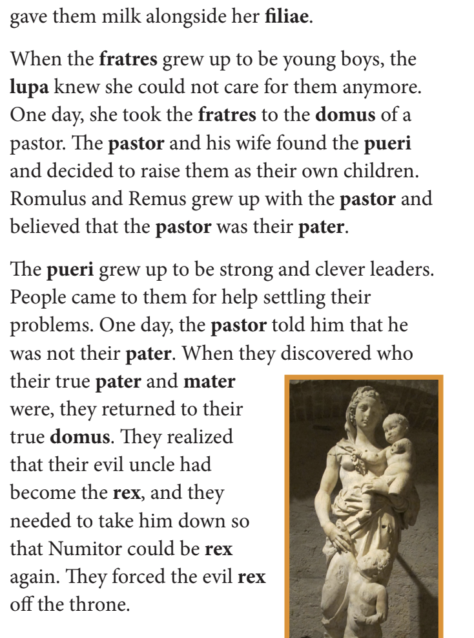
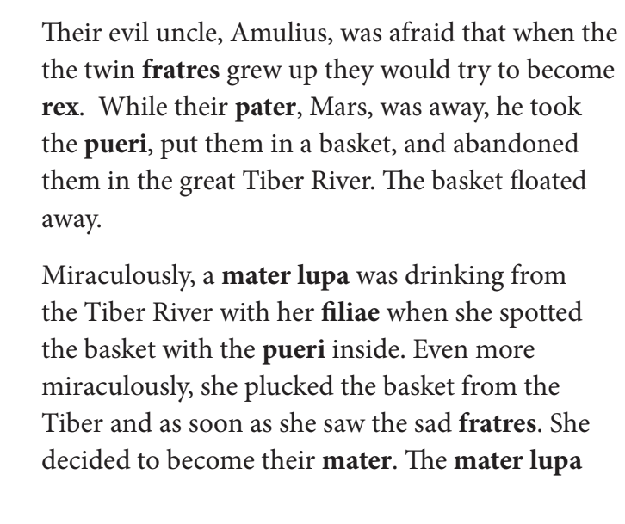
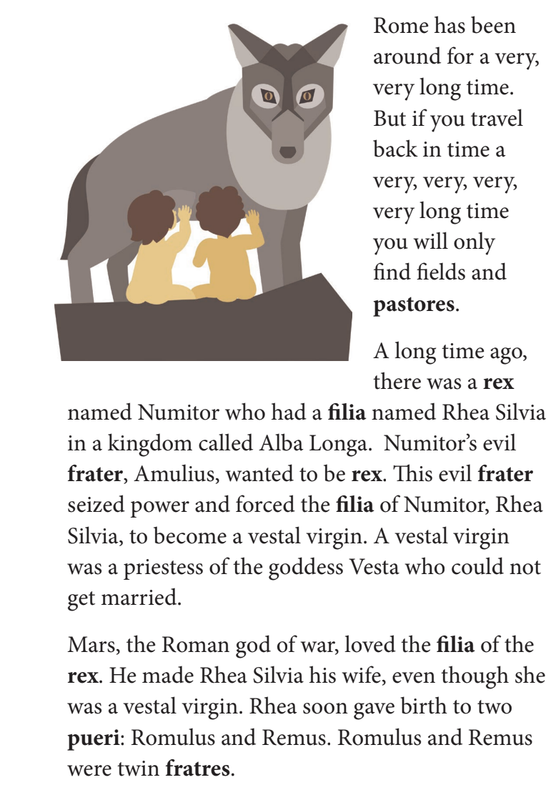
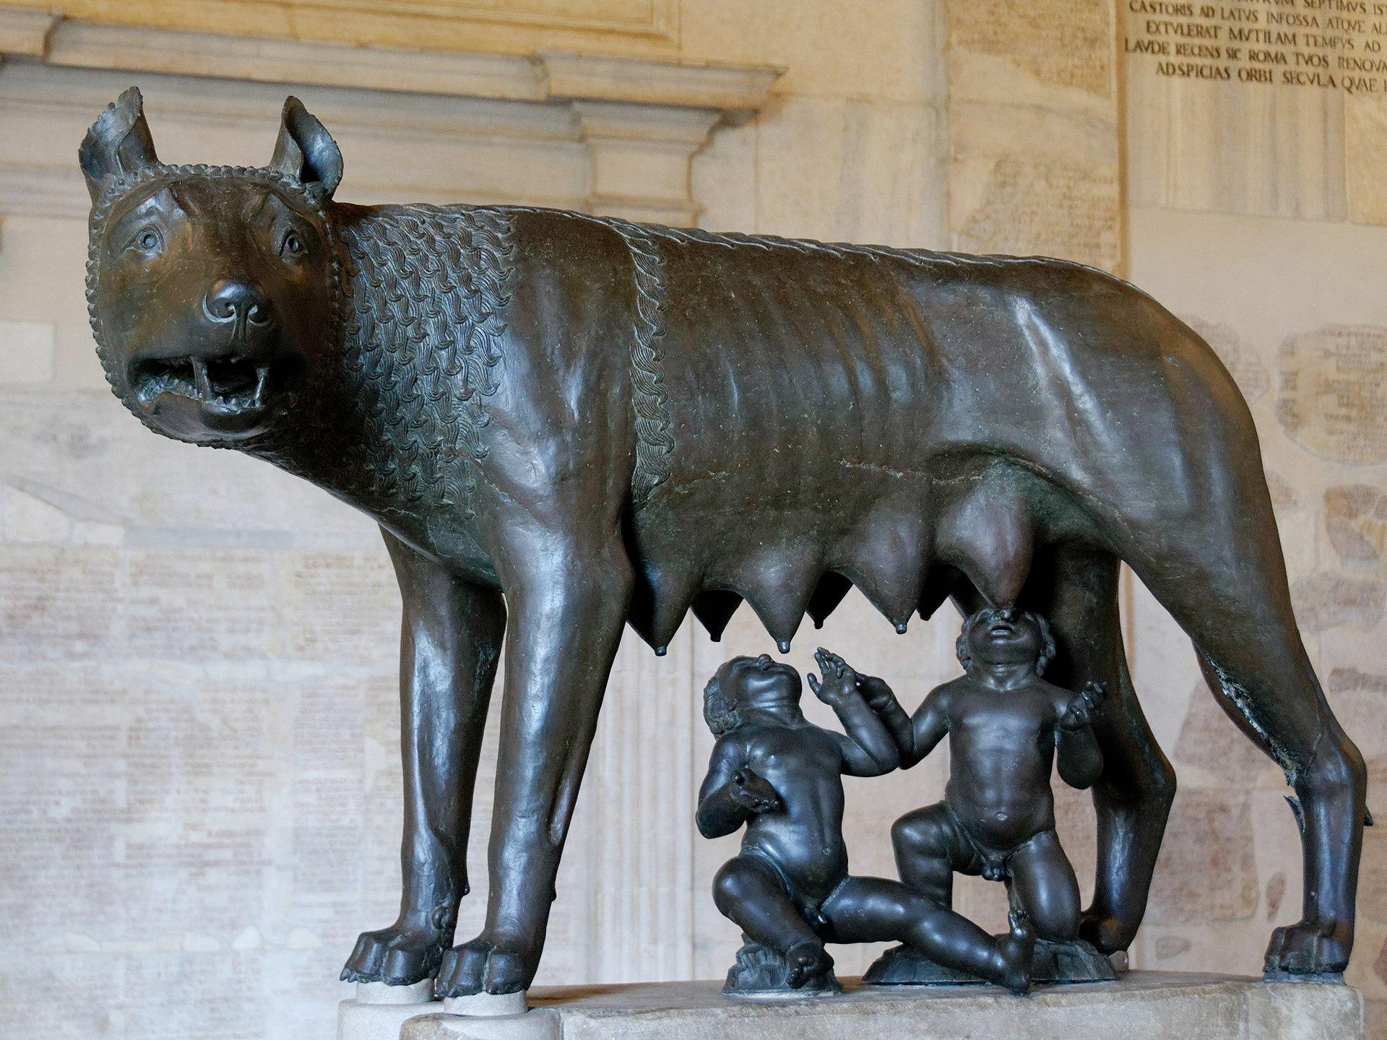
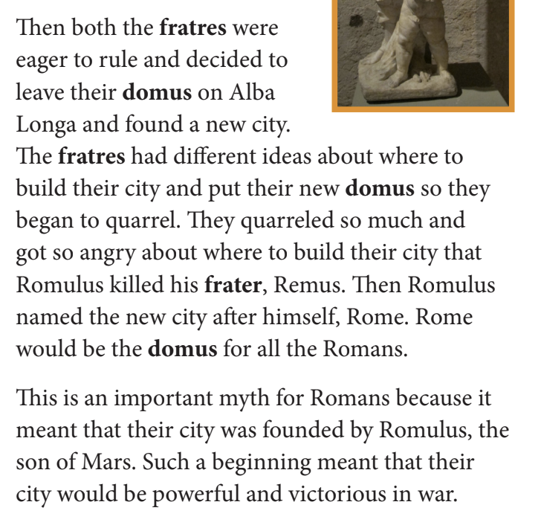
Romulus and Remus

Slide 3
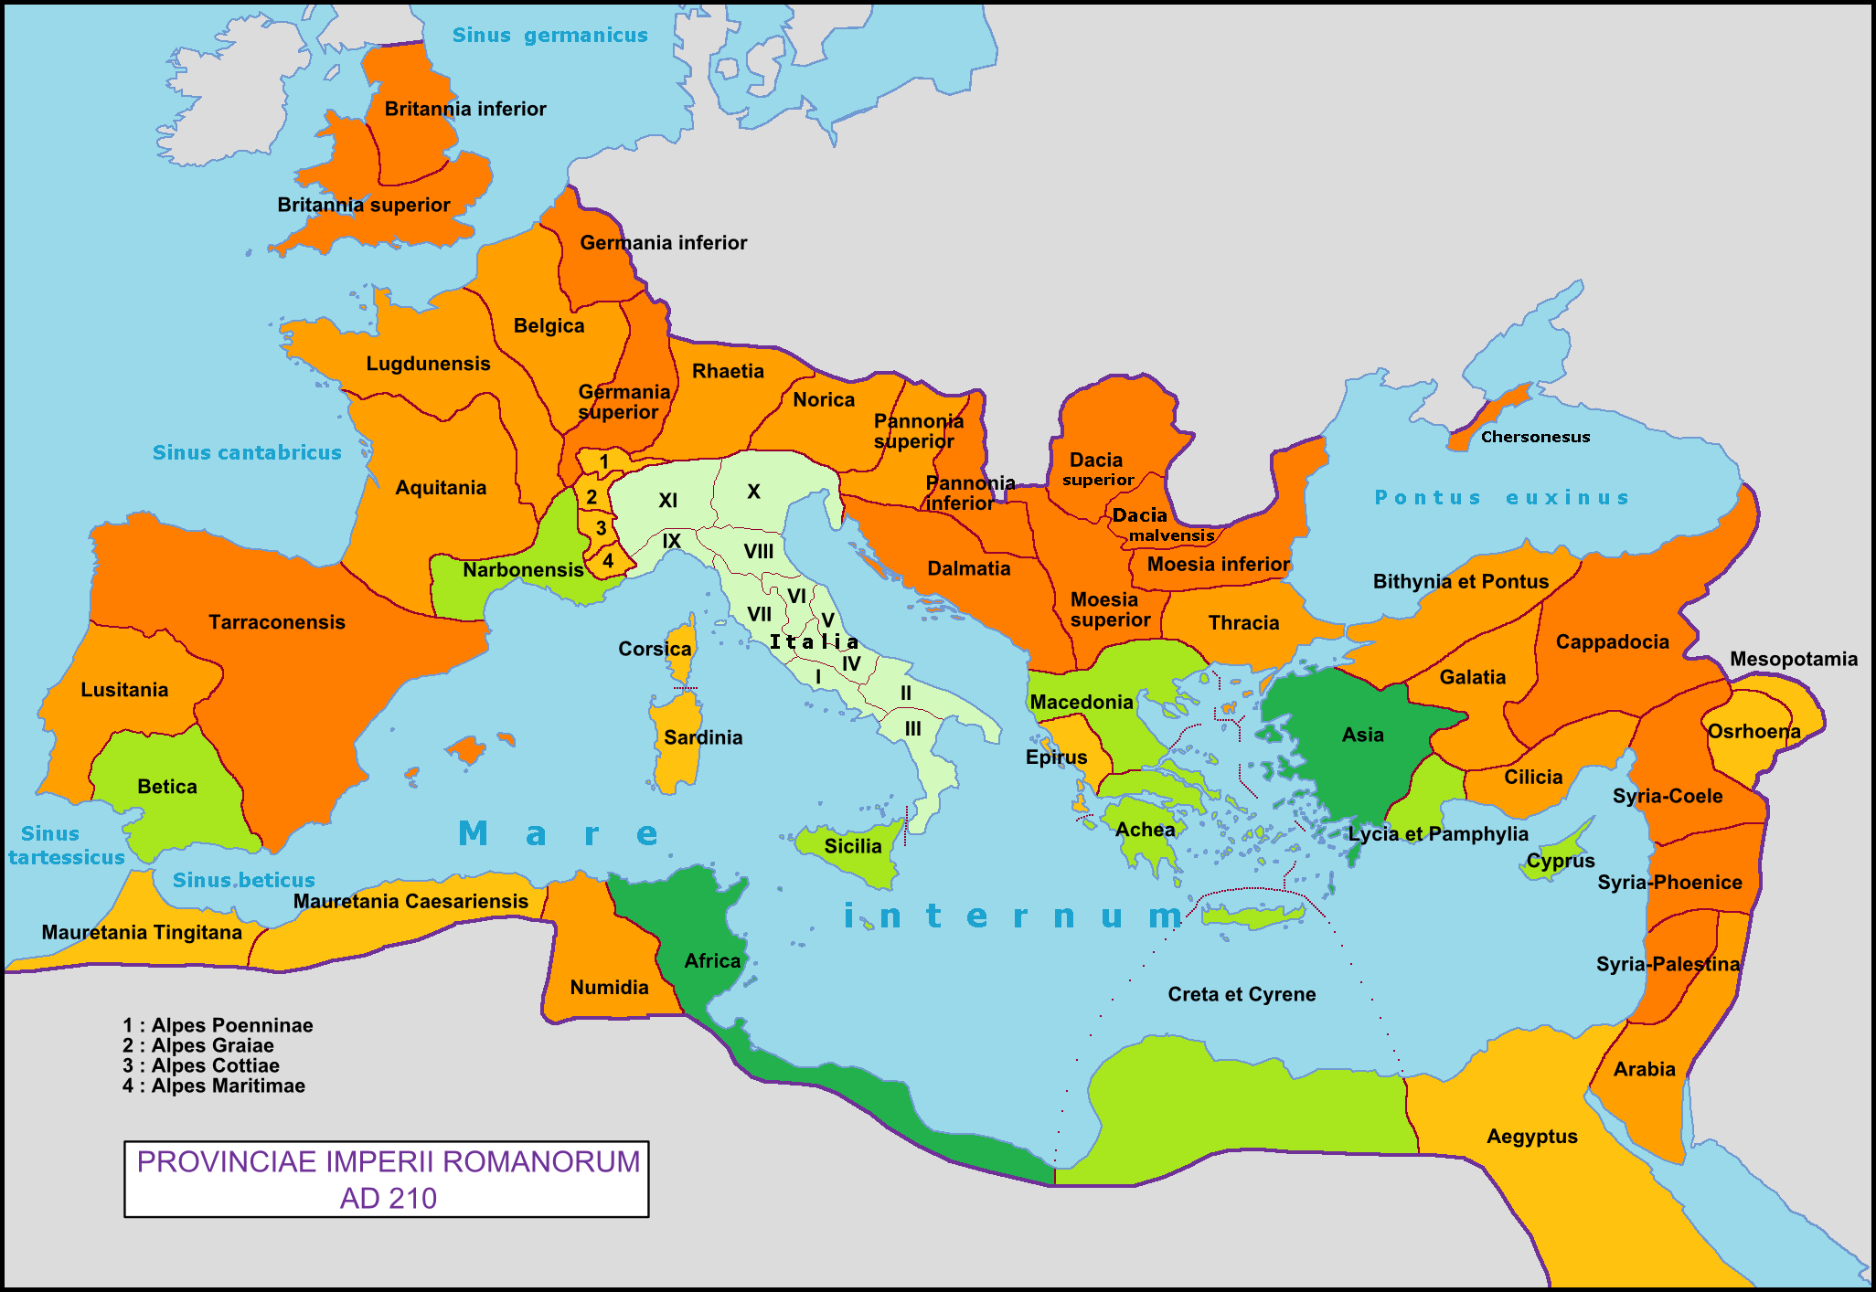
Where, when and by who was Latin spoken?
70 million people, at its height
Ancient Rome + Roman Empire
Existed from 625 BCE to its fall in 476 CE
Notes:
At the height of its existence, Latin was spoken by over 70 million people, most of whom lived within the European region.
Throughout its history, Latin was the official language of Ancient Rome and the Roman Empire, which lasted for about 1500 years. Before Latin, the language that was used throughout most of the Mediterranean was Attic Greek.

Slide 4
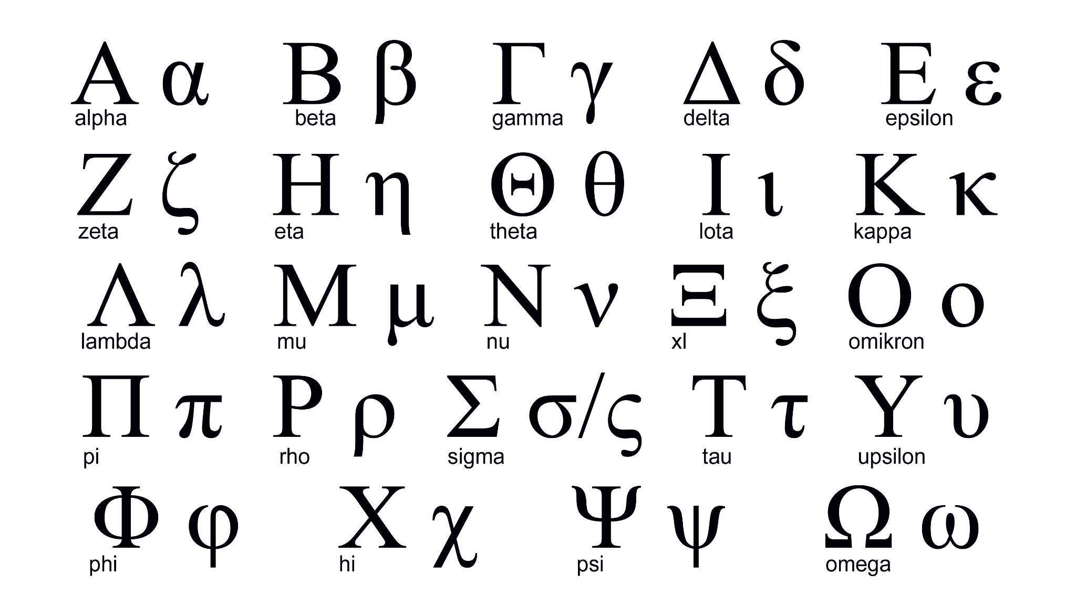
Notes:
Attic Greek is much older than Latin, but Latin replaced Greek and romanized much of the Greek alphabet. Here are some examples:

Slide 5
Latin in our calendar
July and August
September, October, November, and December
Spanish and French, too
Notes:
We also see Latin in our calendar. The months July and August were actually created by Julius Caesar and Augustus because they wanted their own months! Months such as September (septem/seven) October (octo/eight), November (novem/nine), and December (decem/ten) all borrow Latin roots. The only reason why the number they are named after does not line up with the number of months of the year they are is that July and August were added after those months were named. We can also see this in the Spanish (Septiembre, Octubre, Noviembre, Diciembre) and French (Septembre, Octobre, Novembre, Decembre) calendars.

Slide 6
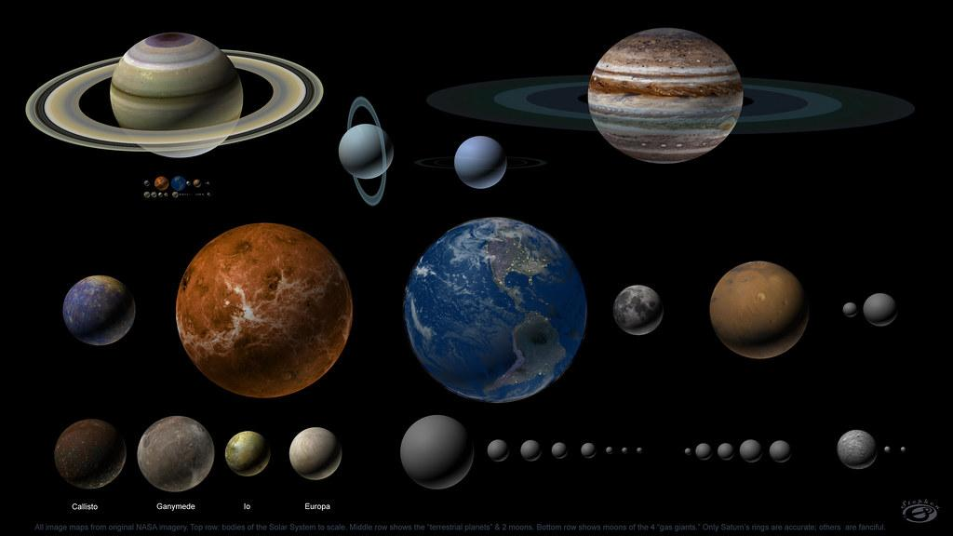
Latin in our Solar System
Planets are named after Roman Gods
Notes:
In our solar system, planets are mostly named after Roman gods and goddesses, such as Venus, Mercury, Jupiter, and Saturn, among others.

Slide 7
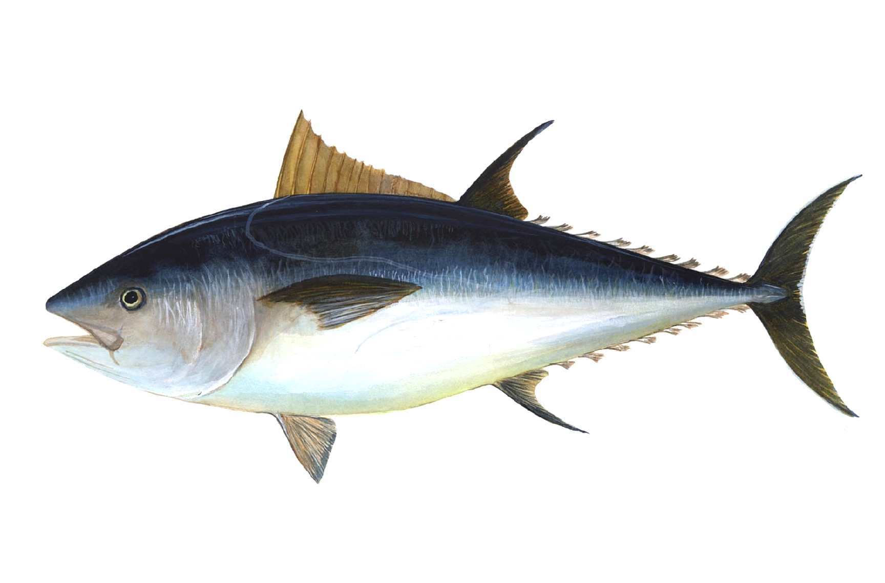
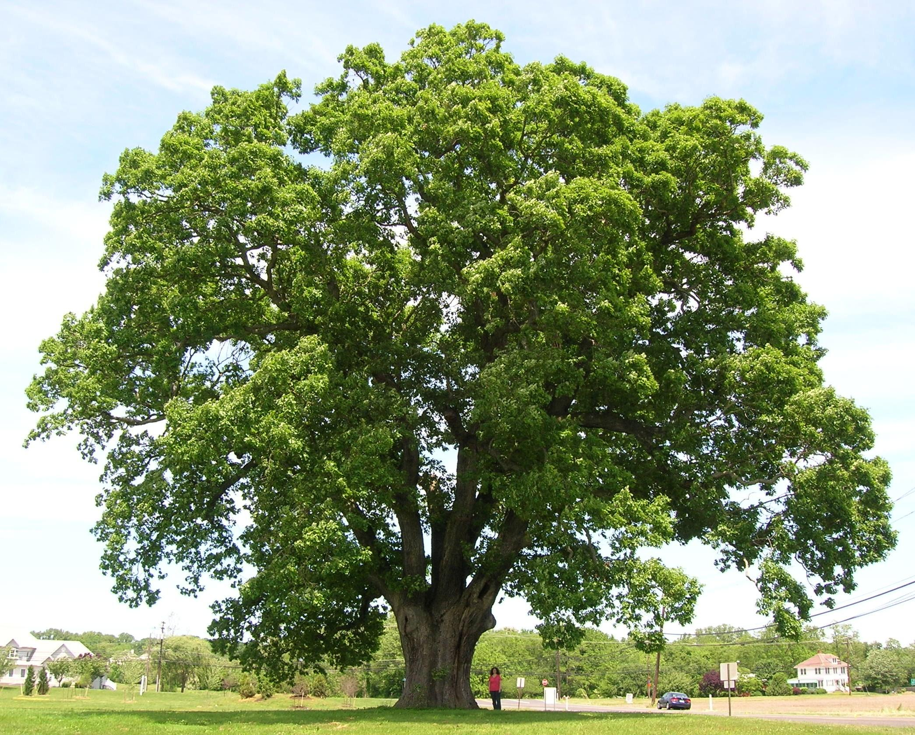
Latin in Science
Thunnus thynnus
Quercus
Notes:
Latin names are given to almost all known plants and animals. Here is a bluefin tuna and an oak tree with their accompanying Latin names

Slide 8
Latin in Education
Graduation Honors
Notes:
In college, one can graduate cum laude (with honors), magna cum laude (with great honors), or even summa cum laude (with the highest honors)

Slide 9
Latin Phrases in English Writing
Et cetera
Exempli gratia
Id est/I.E.
Notes:
Even in English today, Latin phrases are still prevalent. Phrases used such as “et cetera” (and forth), “exempli gratia” (for example), and “id est/ie” (that is)

Slide 10
Latin Phrases in English Speaking
Carpe diem
Bona fide
Extra
Notes:
phrases used in casual English such as “carpe diem” (seize the day), “bona fide” (in good faith), and “extra” (in addition to) are Latin!

Slide 11
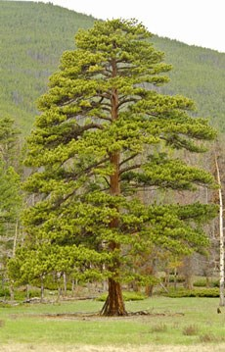
Latin Stems in English
Aqua-
Dorm-
Audi-
Visi-
Circ-
Jur-
Manu-
Pac-
Horti-
Arbor-
Doc-
Notes:
Below are some common Latin stems that you can recognize in English:
Aqua has to do with water
Dorm has to do with sleeping
Audi has to do with hearing
Visi has to do with seeing
Circ has to do with circles
Jur has to do with the legal system
Manu has to do with hands
Pac has to do with peace
Horti has to do with gardening
Arbor has to do with trees
Doc has to do with teaching

Slide 12
Now You Try!
English
Audio
Circle
Visual
Spanish
Agua
Arbol
Dormitorio
French
Jury
Main
Docteur
Notes:
Now you try! See if you can guess the root Latin word in these English, Spanish, and French words mean.

